Slide 1
The Role of Human Decisions in Computer Security Systems
Rick Wash
Associate Professor
Michigan State University

Slide 2
Security is a systems property
Human decisions are part of that system
Interface-based (prompted) decisions — passwords, delaying patching, etc. HCI / Usable security focuses on these
In-the-moment decisions — phishing emails
Systems use decisions — what to use it for? Patching? Extra services?

Slide 3
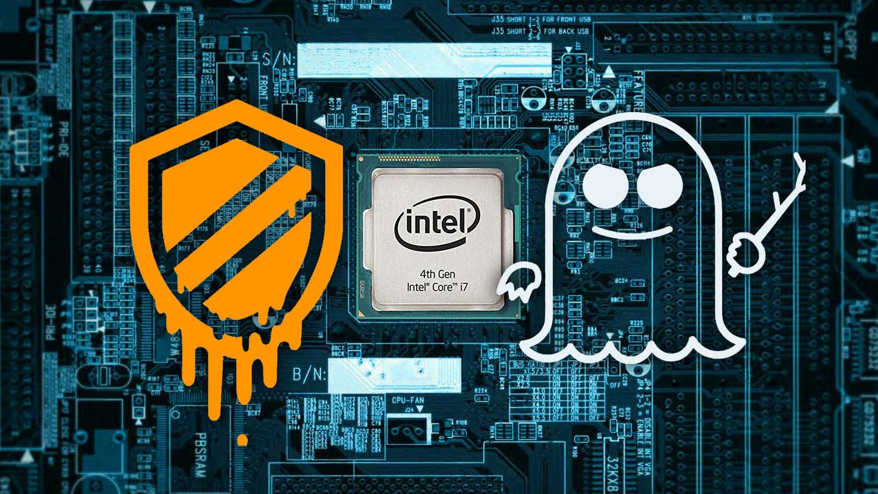
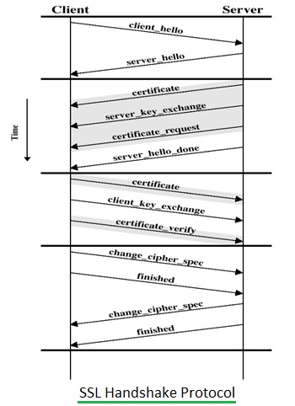
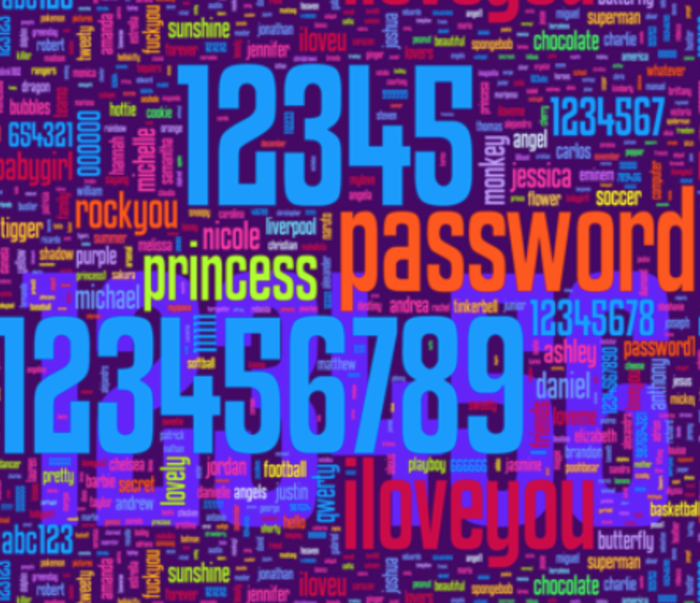
Security is a property of a System
Notes:
Not of individual components.

Slide 4
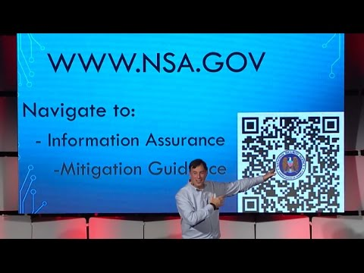
Human decisions play an important role

Slide 5
Everyday Security Decisions
A large proportion of attacks on the Internet
targets vulnerabilities in end users (Symantec)
The majority of computers are compromised using
vulnerabilities for which a security update was
available but had not yet been installed (Microsoft)

Slide 6
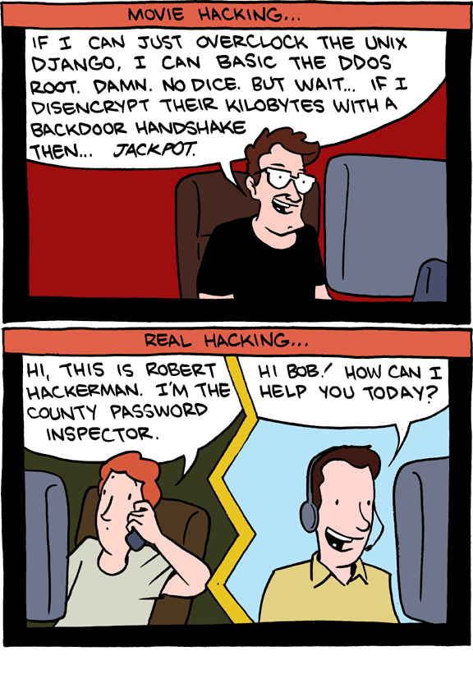
Source: http://www.smbc-comics.com/?id=2526

Slide 7
Security is a property of a System
Notes:
Not of individual components.

Slide 8
Prompted (interface-based) Decisions
Systems use (adoption-based) Decisions
In-the-moment (detection-based) Decisions

Slide 9
Prompted (interface-based) Decisions
Password Re-use Decisions
Systems use (adoption-based) Decisions
In-the-moment (detection-based) Decisions

Slide 10
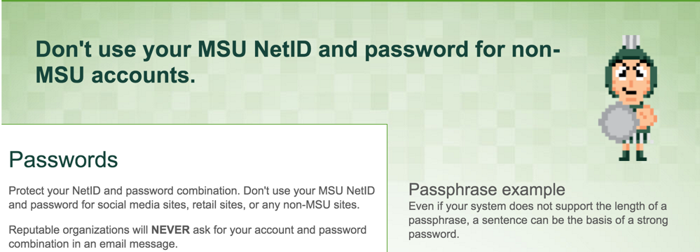
Notes:
Organizations have little control over re-use, but this is a major vulnerability.

Slide 11
How do people make choices
about password re-use?

Slide 12
Study details
Browser Plugin
Observe ALL websites visited
Collect Password use:
Measure, hash password
Notes:
Opt-out via Private Browsing / Incognito mode
Similar passwords? Within but not across person comparison

Slide 13
Study details
134 University Students
(Excluding Comp Sci)
Collected data for 6 weeks
53% Women
46% Men
$70 compensation
Notes:
This is just part of a larger study

Slide 14
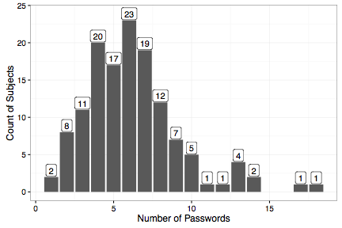
Notes:
Explain graph (axes, etc.)
Median: 6
Most between 4 and 8
If you take those passwords and rank them within a subject by re-use <click>

Slide 15
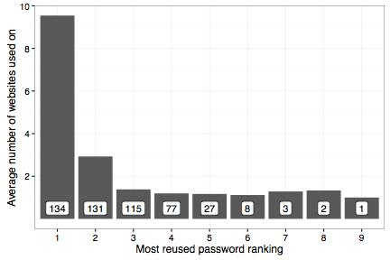
Notes:
Advice says "unique" -- any reuse is bad.
Password is only as secure as the weakest of those 10 sites

Slide 16
What passwords get re-used?
Throw-away
Password?
Best password?
Notes:
Measured “complexity” using Hartley entropy

Slide 17
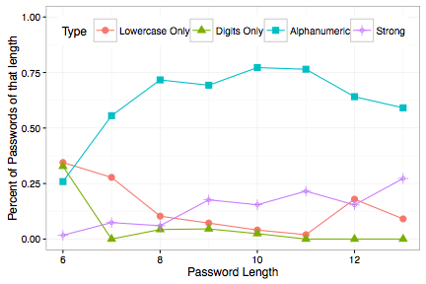
Notes:
Florêncio and Herley, 2007 (WWW conference)
Average length: 8.98
Character sets: 2.29

Slide 18
 | Password Re-used?
(Intercept) | -1.07 ***
Complexity Ranking | -0.04 **
Times entered into each website | 0.18 ***
Uses a Password Manager | 0.00
R²GLMM_{c} | 0.32

Slide 19
People re-use complex passwords
 | Password Re-used?
(Intercept) | -1.07 ***
Complexity Ranking | -0.04 **
Times entered into each website | 0.18 ***
Uses a Password Manager | 0.00
R²GLMM_{c} | 0.32

Slide 20
People re-use frequently
entered passwords
 | Password Re-used?
(Intercept) | -1.07 ***
Complexity Ranking | -0.04 **
Times entered into each website | 0.18 ***
Uses a Password Manager | 0.00
R²GLMM_{c} | 0.32

Slide 21
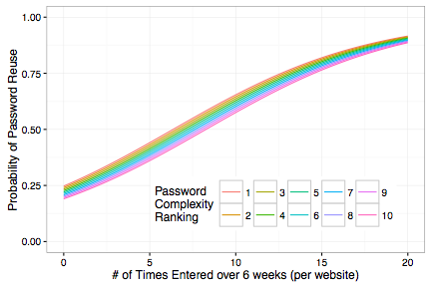
People re-use frequently
entered passwords
Notes:
People pick a strong(ish) password, enter it in frequently to memorize it, and then re-use it because it it already memorized

Slide 22
Password managers don’t help
 | Password Re-used?
(Intercept) | -1.07 ***
Complexity Ranking | -0.04 **
Times entered into each website | 0.18 ***
Uses a Password Manager | 0.00
R²GLMM_{c} | 0.32
Notes:
Need transition to next slide

Slide 23
 | # Websites (non-university)
(Intercept) | 0.87 ***
Complexity (rank) | -0.01
Frequency of Entry (per website) | 0.00
Uses Password Manager | 0.01
University Password | 3.20 ***
R²LMMc | 0.124

Slide 24
Additional Results
(See paper for details)
Incorrect passwords are frequently
passwords to other sites
People accurately self-report password re-use
(r=0.12)

Slide 25
Summary
People re-use passwords that
they have to enter frequently

Slide 26
Potential Explanations
1) People pick a complex password, enter it frequently to memorize it, and then re-use it. [ª]
2) Organizations require complex passwords be entered frequently. Already memorized for re-use. [^{b}]
[ª] J. Bonneau and S. Schechter. “Towards reliable storage of 56-bit secrets in human memory.” USENIX Security, 2014
[^{b}] D. Florêncio and C. Herley. “Where Do Security Policies Come From?” SOUPS, 2010
Notes:
This second explanation has an important implication: <click>

Slide 28
Prompted (interface-based) Decisions
Patching Decisions
Systems use (adoption-based) Decisions
In-the-moment (detection-based) Decisions

Slide 29
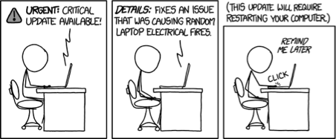
Kami Vaniea, Emilee Rader, and Rick Wash. “Betrayed By Updates: How Negative Experiences Affect Future Security” CHI 2014
Notes:
Examples of consistent, not consistent, etc.
Talk more about analysis -- ask people, then look in logs. Aggregation challenge
End: software updates rely on amateur security
Broken feedback loop?

Slide 30
Why Don’t People Update?
Semi-structured Interviews
37 Non-expert Windows users
Recruited through registrar
(mostly grad students)
Also collected survey, log data (another paper)

Slide 31

Surprise User Interface Changes

Slide 32
I also always worry that everything is gonna get screwed up, especially for iTunes updates or things like that because they’re always reconfiguring the layout of stuff, and I’m like, ‘I don’t want you to do that. Just, like, leave it alone…’
— Rachel

Slide 33
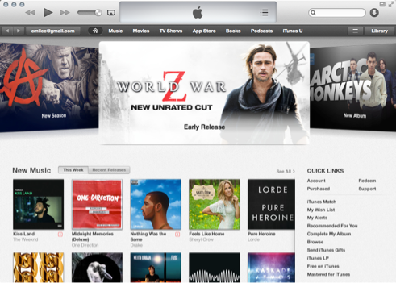

This is a web
page rendered
using WebKit

Slide 34

Unused and Unrecognized Software

Slide 35
I don’t know why the hell I need a Java so I ignore it... I’m just pissed off and I think I have a tendency then, when like I see Java pop up in the corner, I’m like, ‘Fuck you, Java.’
— Lauren

Slide 36

Currently Functional Software

Slide 37
I just don’t see what an update to [AdobeReader] can do. I mean it’s PDF files. Its viewing them...”
— Justin

Slide 38
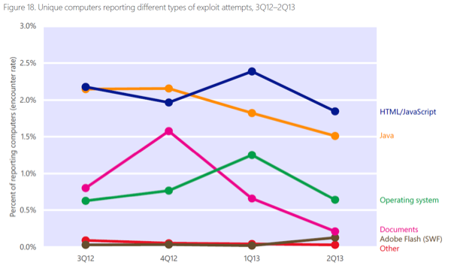
iTunes
Java
Adobe
Microsoft Security Intelligence Report, V13, 2013

Slide 39
Why People Don’t Update
Surprise User Interface Changes
Unused and Unrecognized Software
Currently Functional Software

Slide 40
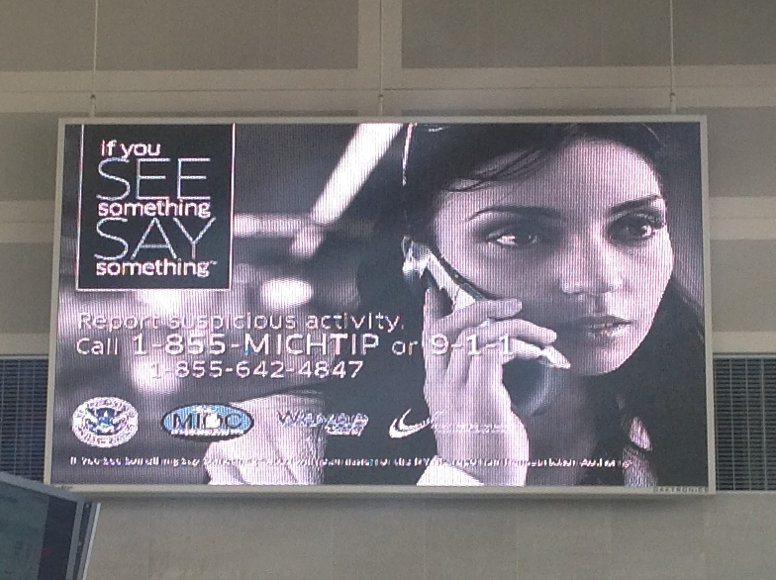

Slide 41
“If you ask amateurs to act as front-line security personnel, you shouldn't be surprised when you get amateur security.”
–Bruce Schneier, Wired 2007

Slide 42
“Whenever possible, secure system designers should find ways of keeping humans out of the loop.”
–Lorrie Faith Cranor, "A Framework for Reasoning About Human in the Loop” (2008)

Slide 43
Microsoft Windows Update
Windows 95: Manually visit website
Windows 98: Critical update installation tool
Windows ME: Optional Automatic Updates
Windows XP SP2: Default Automatic Updates
Notes:
After SP2, 90% had fully updated computers compared to only 5% of SP1 users

Slide 44
Understanding: Interview and Survey
Behavior: Log Data from computer

Slide 45
37 students running Windows 7
Matched log data with survey, interviews
Notes:
Graduate students
Coding of interview data
Matching interview and survey data
Aggregation of individual events into aggregate patterns in log data
Matching up beliefs with what happened

Slide 46
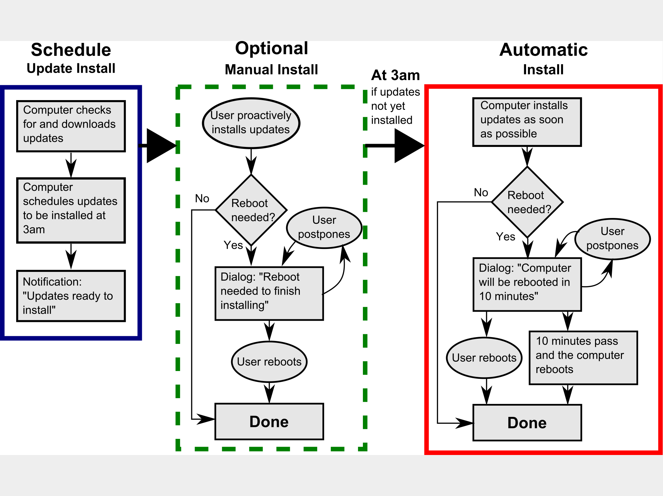

Slide 47
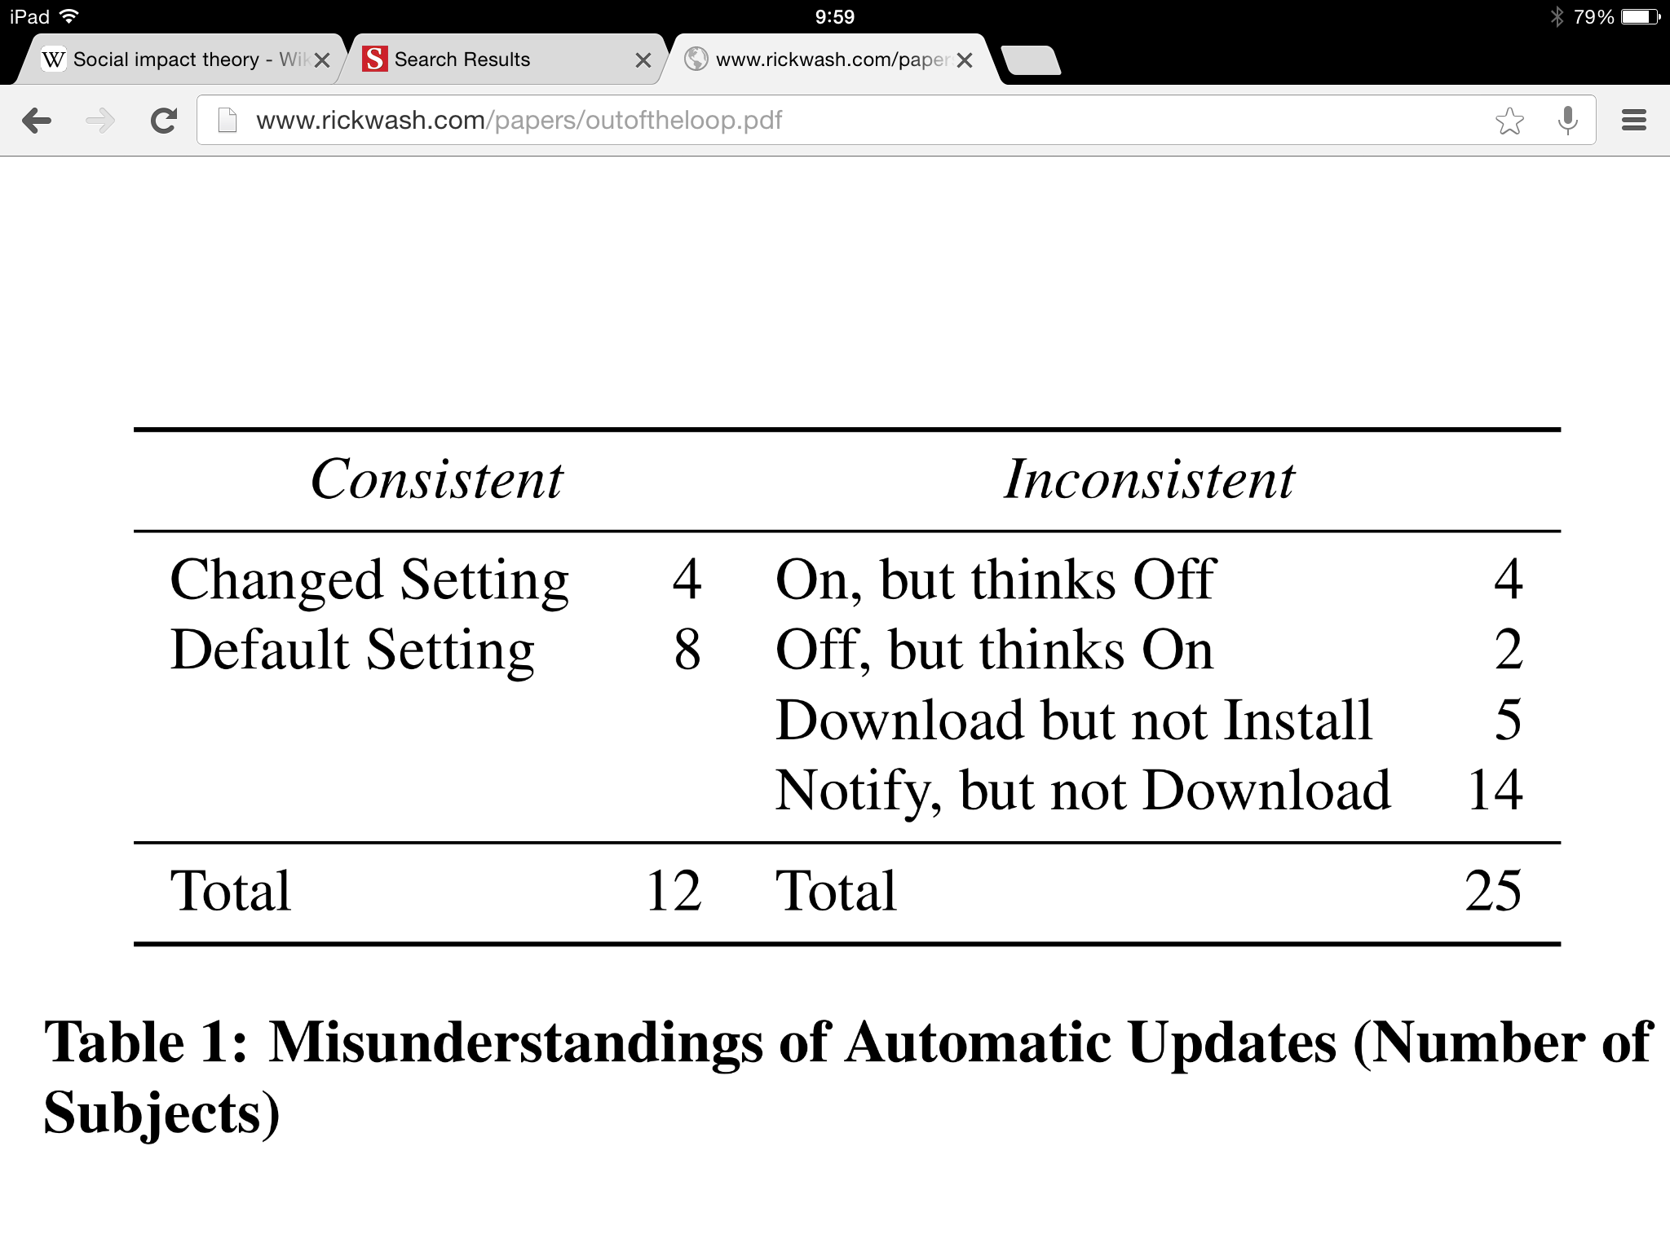
Misunderstanding Updates
Notes:
"Actually I didn’t know that I clicked yes for auto up-dating. It just popped up."
"I mean it usually prompts me when there is an update to be installed, but I don’t know if that means auto-update or not." -- survey answer download only

Slide 48
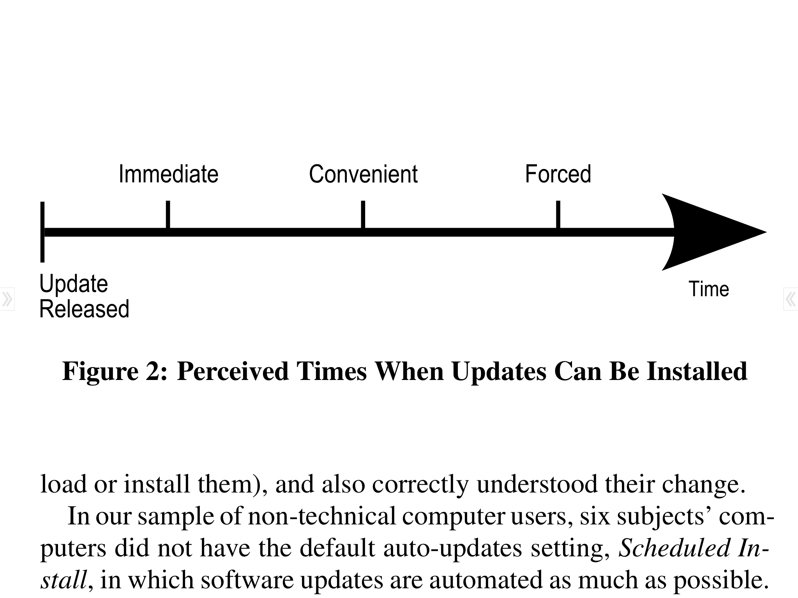
Misunderstanding Timing

Slide 49
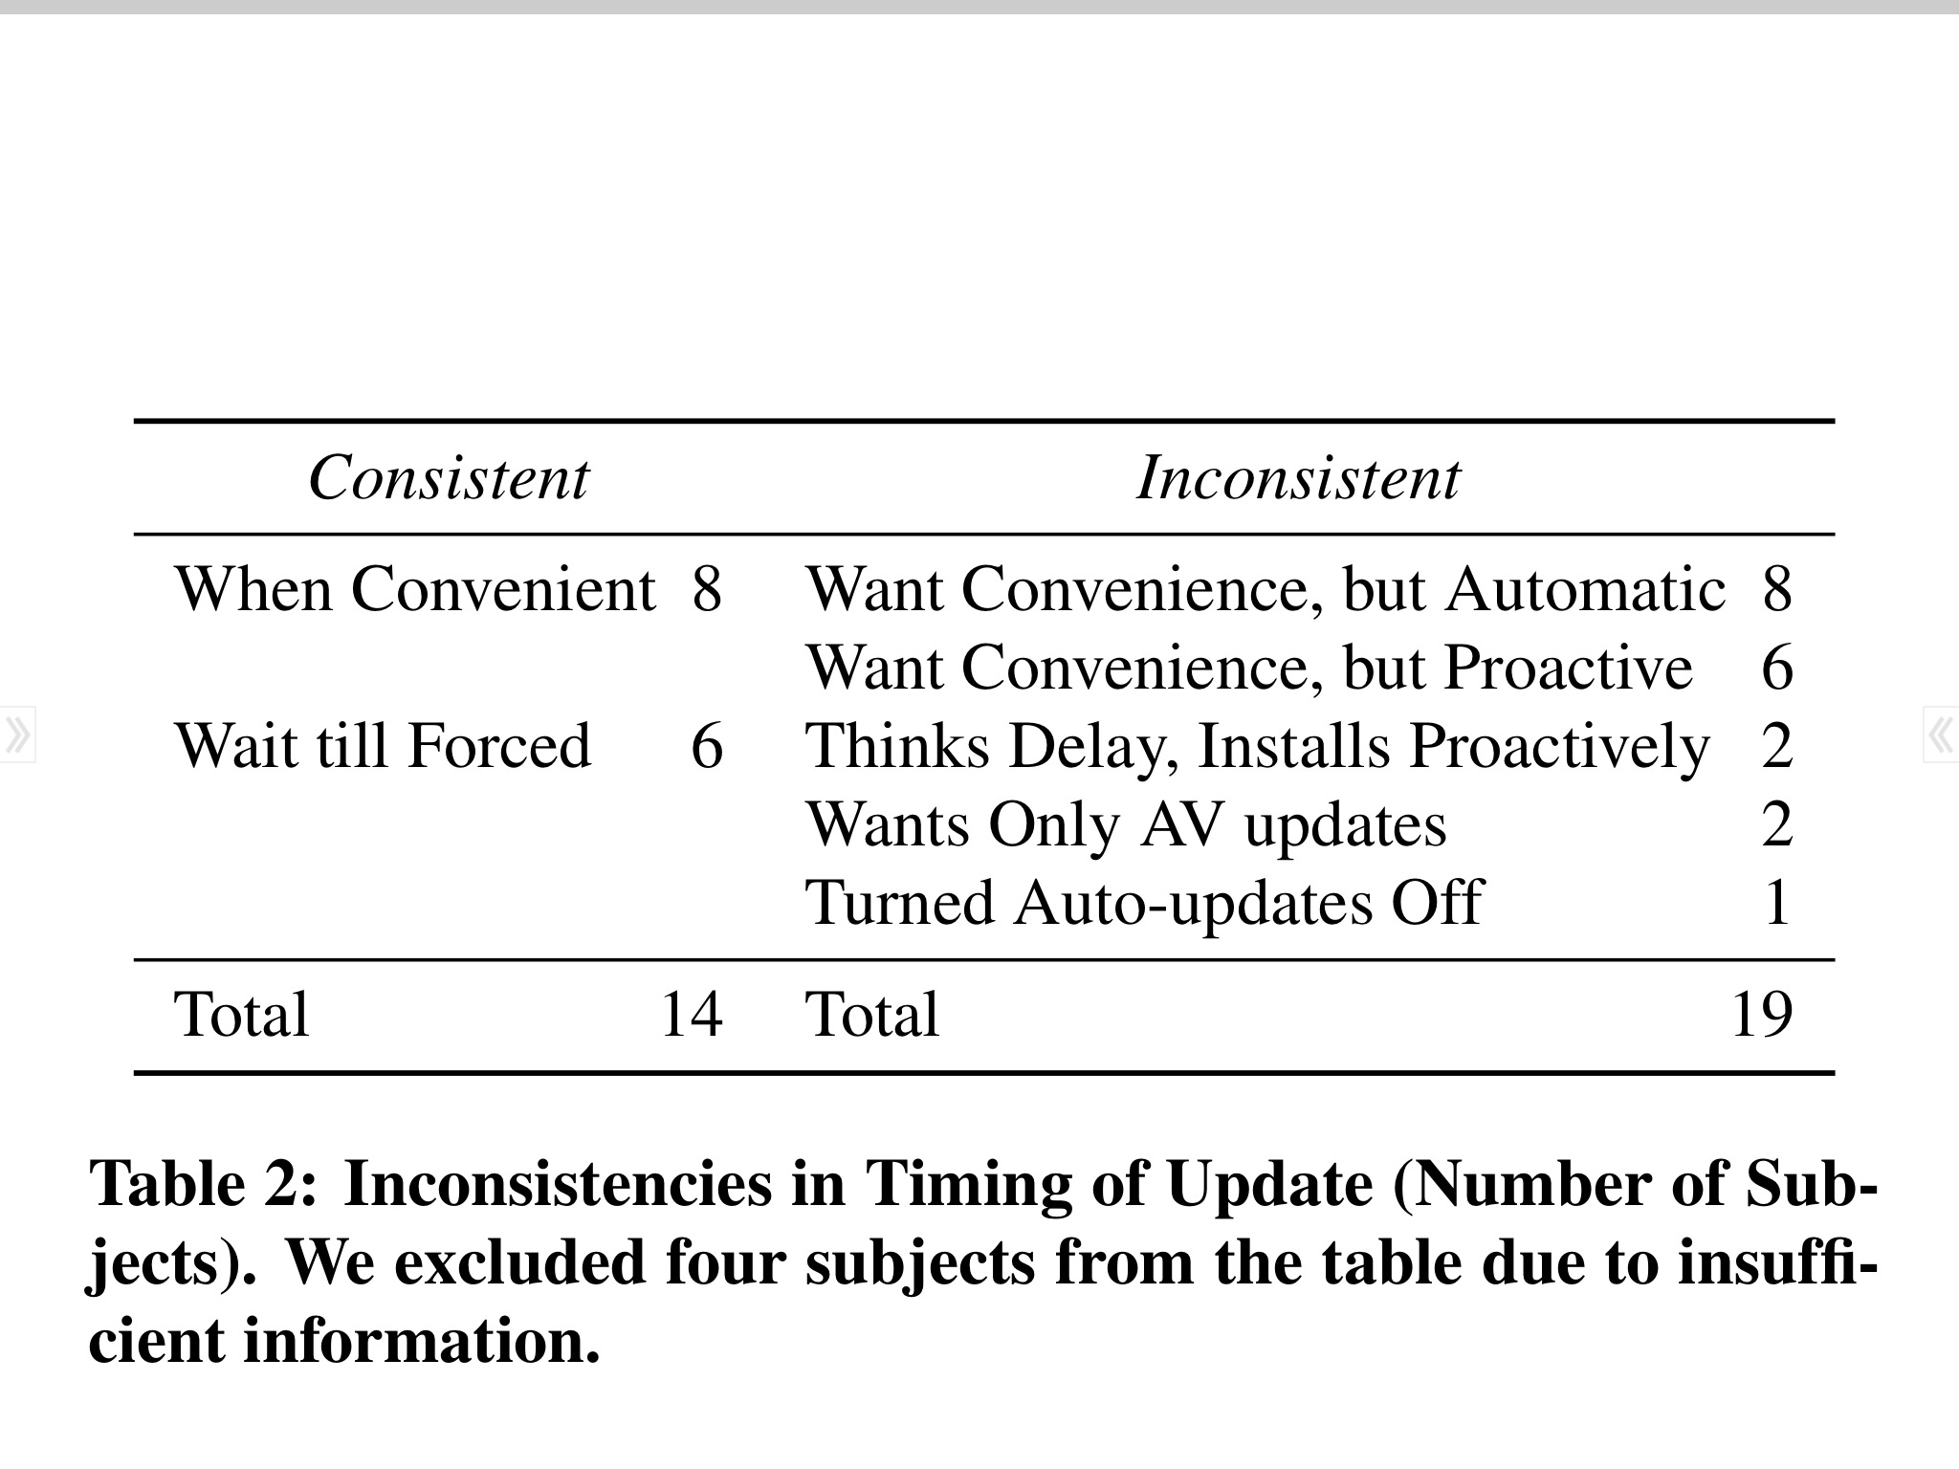
Misunderstanding Timing
Notes:
4 subjects not enough interview data
3 types convenient -- 22 subjects

Slide 50
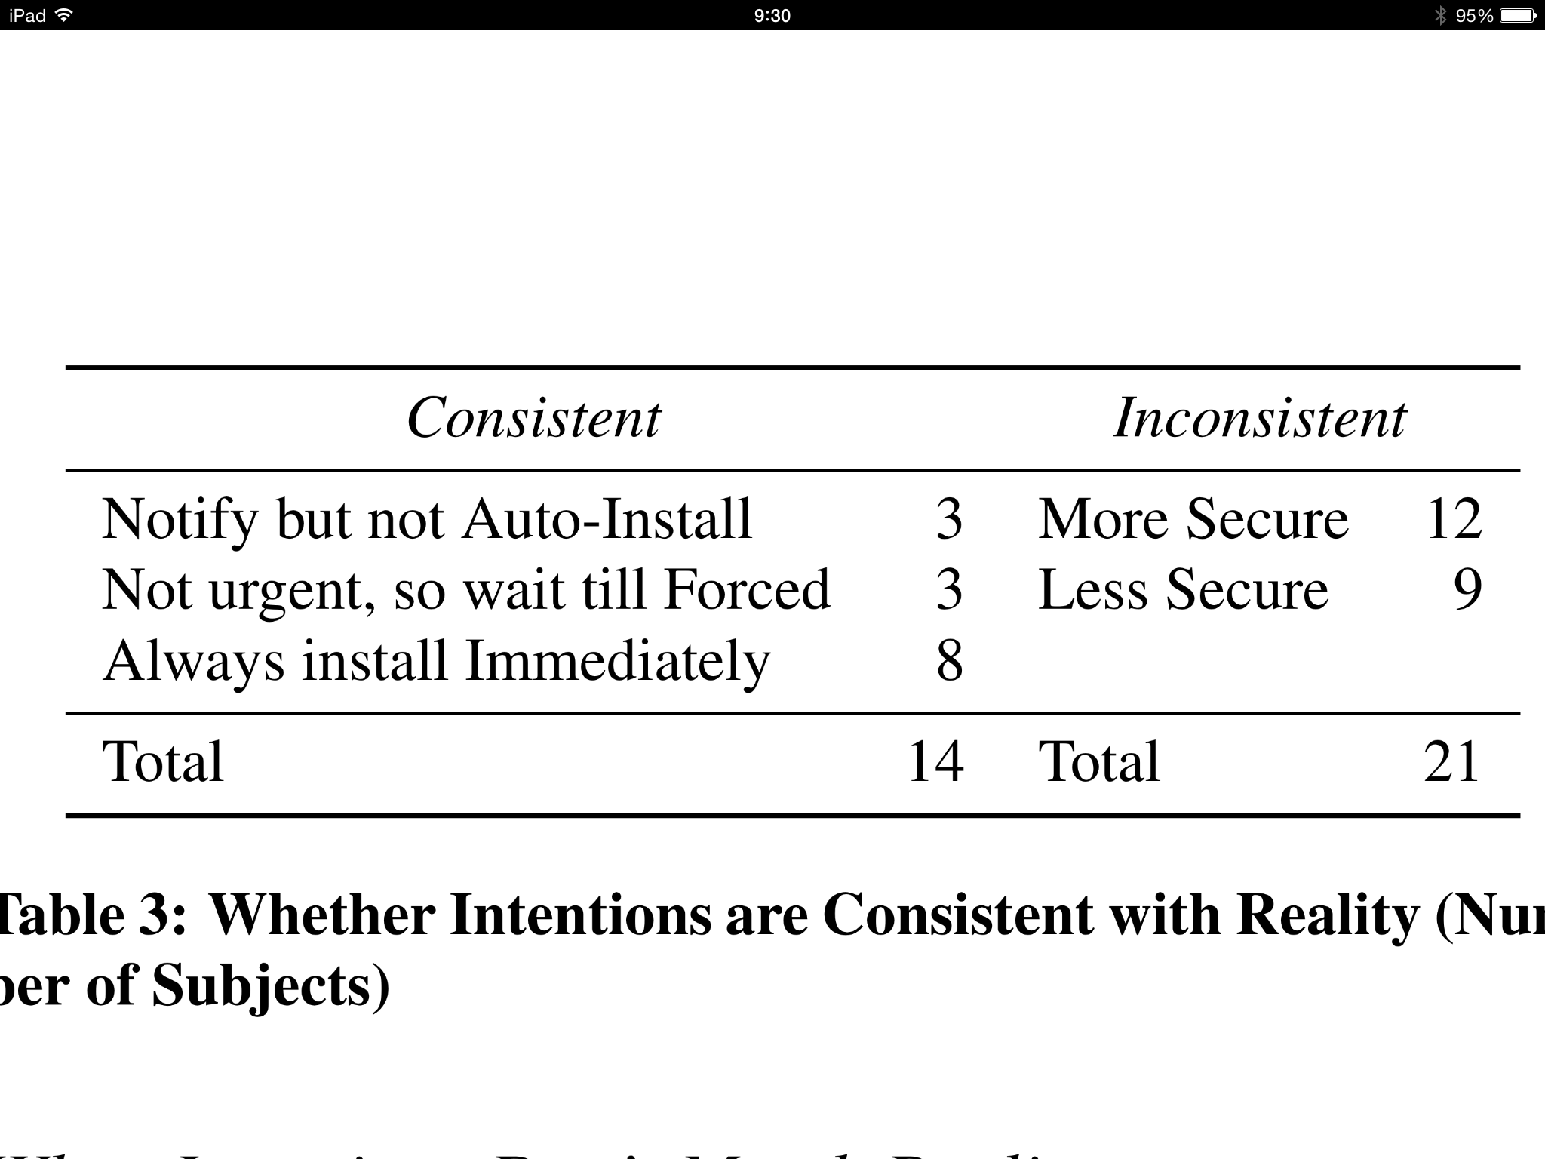
Inability to Execute on Intentions
Notes:
12 Left computer more secure than intended
"But I know I played around with some of the settings on my computer so that it wouldn’t automatically up-date everything. Because it would just slow down my computer to a crawl." -- actually on

Slide 51

Steadily removing humans from decision-making
Difficulty understanding, executing on intentions
–Johnny Appleseed
Notes:
Beethoven's 5th vs. chopsticks

Slide 52
Practice makes perfect
–Johnny Appleseed
Notes:
Beethoven's 5th vs. chopsticks

Slide 53
If you remove the human from the loop, then you make it harder to learn about security
–Johnny Appleseed

Slide 54
“Whenever possible, secure system designers should find ways of keeping humans out of the loop.”
–Lorrie Faith Cranor, "A Framework for Reasoning About Human in the Loop"

Slide 55
Intention-Behavior Gap in Software Updates
Rick Wash, Emilee Rader, Kami Vaniea, and Michelle Rizor. “Out of the Loop: How Automated Software Updates Cause Unintended Security Consequences” Proceedings of the Symposium on Usable Privacy and Security (SOUPS). Menlo Park, CA. July 2014.

Slide 56
Intention-Behavior Link
Sheeran ‘02
Meta-Meta-Analysis
Overal r=0.53
“It is those participants who fail to act upon their positive intentions who are mainly responsible for the Intention-Behavior gap”

Slide 57
Intention: Interview and Survey
Behavior: Log Data from computer
37 users (mostly non-technical grad students)
Topic: Software updates

Slide 59
Intended Settings
Notes:
"Actually I didn’t know that I clicked yes for auto up-dating. It just popped up."
"I mean it usually prompts me when there is an update to be installed, but I don’t know if that means auto-update or not." -- survey answer download only

Slide 60
Intended Timing

Slide 61
Intended Timing
Notes:
4 subjects not enough interview data
3 types convenient -- 22 subjects

Slide 62
Intended Security
Notes:
TODO: rehearse — find a better way to explain this

Slide 63
I also always worry that everything is gonna get screwed up, especially for iTunes updates or things like that because they’re always reconfiguring the layout of stuff, and I’m like, ‘I don’t want you to do that. Just, like, leave it alone…’
— Rachel

Slide 64
Accuracy of Self-report
Visible Actions
Installing an ad-blocking extension
Installing an update after a prompt (iTunes)
Use good passwords
Less Visible Choices
If an ad-blocker is running
Chrome and Firefox updates
Password special characters
Rick Wash, Emilee Rader, and Chris Fennell. “Can People Self-Report Security Accurately? Agreement Between Self-Report and Behavioral Measures” CHI 2017.

Slide 65
Good intentions don’t always
lead to secure behavior
Influencing intentions isn’t enough
Security decisions are frequently made:
while doing something else
relatively quickly
with lots of uncertainty

Slide 66
Dependencies between Decisions

Slide 67

Icons made by Freepik from www.flaticon.com
Notes:
borders == transitions of control and responsibility
Interdependency == vulnerability in one creates a vulnerability in dependent systems

Slide 68
Icons made by Freepik from www.flaticon.com
Notes:
DNS affects web browsers.
“an insecurity in DNS that allows an attacker to create unauthorized DNS entries will also allow the attacker to violate security guarantees in the web browser”

Slide 69

Icons made by Freepik from www.flaticon.com
Icon made by Freepik from www.flaticon.com
Notes:
Traditional use of computer issues — weak passwords, ignoring warnings, not patching, etc.
Two additional forms of interdependency that are under-appreciated:
each user uses many systems
each system has many users

Slide 70
Icons made by Freepik from www.flaticon.com
Notes:
Password re-use: In a study of 122 users, passwords are re-used more if they have to be entered frequently — and especially if complex.
Many websites (esp. employers) have “timeout” policies; this leads to re-use on other sites, that then can be compromised
iTunes 11 examples. iTunes 11 updated interface, came out as a normal software “patch”. This upset users, who then stopped installing patches for other software.

Slide 71
Notes:
Advice says "unique" -- any reuse is bad.
Password is only as secure as the weakest of those 10 sites

Slide 72
Icons made by Freepik from www.flaticon.com
Notes:
Password re-use: In a study of 122 users, passwords are re-used more if they have to be entered frequently — and especially if complex.
Many websites (esp. employers) have “timeout” policies; this leads to re-use on other sites, that then can be compromised
iTunes 11 examples. iTunes 11 updated interface, came out as a normal software “patch”. This upset users, who then stopped installing patches for other software.

Slide 73
Icons made by Freepik from www.flaticon.com
Icon made by Freepik from www.flaticon.com
Notes:
Collected security stories told by other users; 72% had a “lesson”. e.g. “don’t click on links in email” or “be careful about posting information to FB” or “trust in IT; they will protect you from scammers”.
Under-appreciated vulnerability: users spreading insecure practices (e.g. “don’t write down passwords”)
Under-appreciated opportunity: users teaching each other good practices
What is in common? Human learning -- learn from other systems, people and apply that learning. Too much focus on "education" and "training"; not enough on other places we learn.

Slide 74
Improving Password Decisions

Slide 75
Prompted (interface-based) Decisions
Systems use (adoption-based) Decisions
In-the-moment (detection-based) Decisions

Slide 76
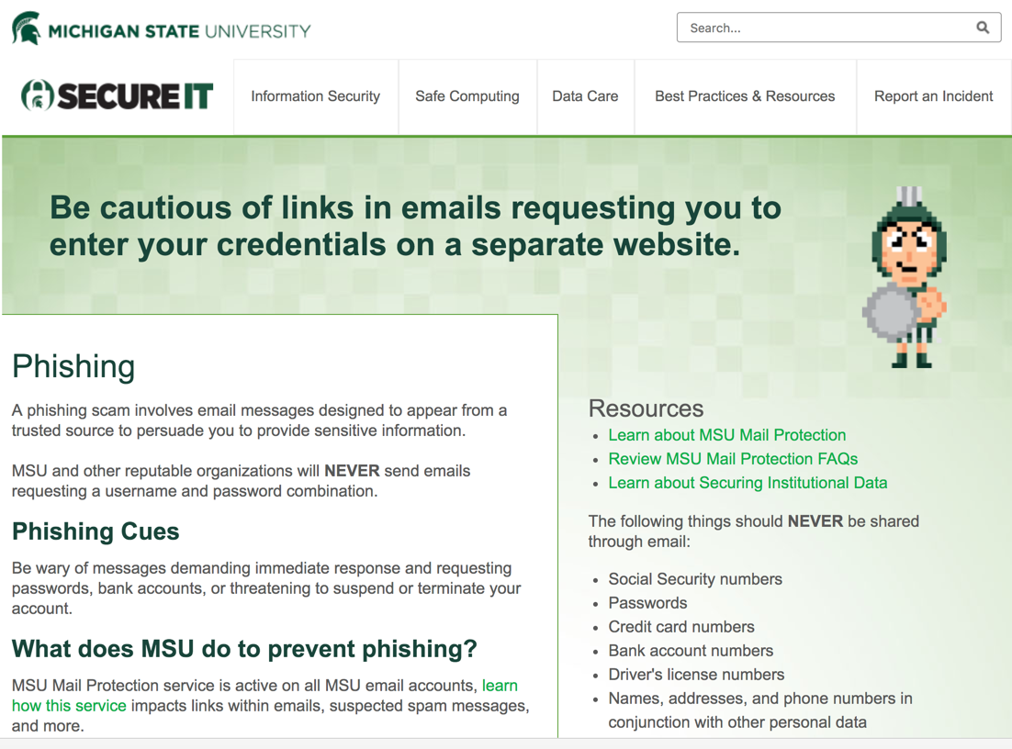

Slide 77
1. People learn about cybersecurity through stories
2. Stories contain valuable information that is different from other sources
3. Stories have the potential to improve cybersecurity decisions
4. Stories can help, but must be used carefully

Slide 78
Definition of “decision”
Singular evaluation
Typicality, action, mental simulation
Problem detection, “gut feelings”, and “vicarious experience”

Slide 79
Decision:
a choice point where more than one
reasonable option exists, even if those
options are not considered
Notes:
A decision can exist even if the person doesn’t think it was a decision. “I just know what to do”

Slide 80
Recognition-Primed Decision Making
Recognize the situation as typical of a type of situation they are familiar with
Identify goals, expectations about the situation, and past actions
If similar enough, follow past action
If not, mentally simulate taking the action in this situation, and adjust plan
Notes:
Fast decisions, don’t need to consider alternatives
More about recognizing situations than deciding between alternatives

Slide 81
How do you train recognition?
Variety of experiences
Stories can act as vicarious experience

Slide 82
1. People learn about cybersecurity through stories
2. Stories contain valuable information that is different from other sources
3. Stories have the potential to improve cybersecurity decisions
4. Stories can help, but must be used carefully

Slide 83
Embedded Phishing training
Send people a (fake) phishing email
When they click on it, display a training message

Slide 84
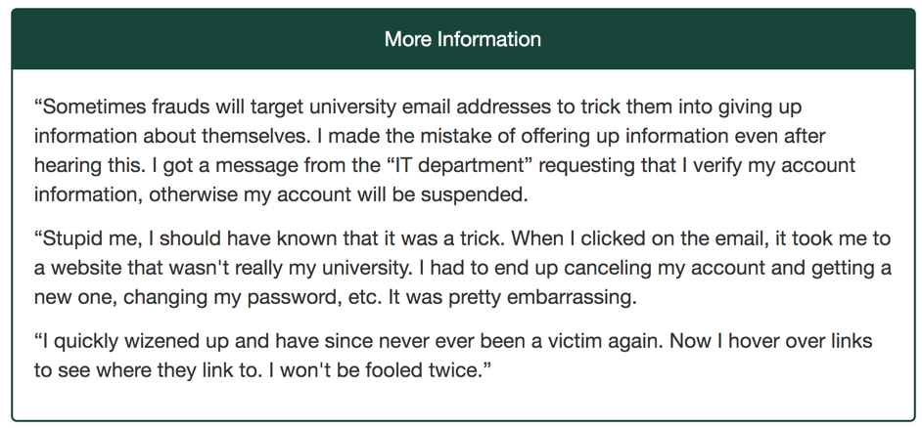

Slide 85
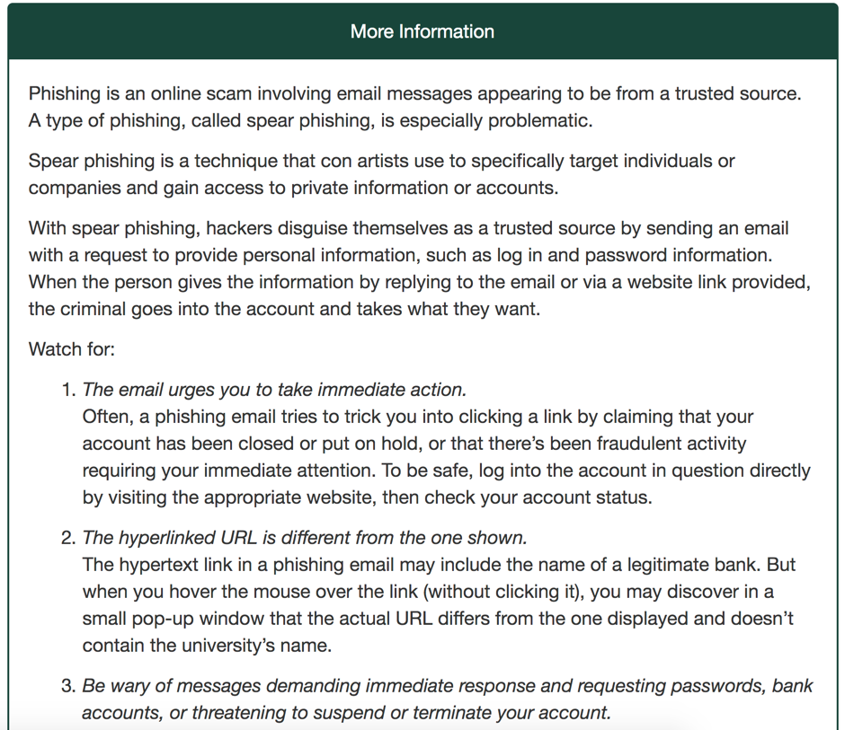

Slide 86
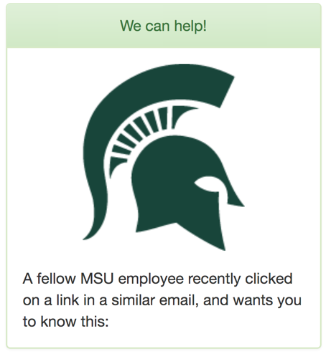
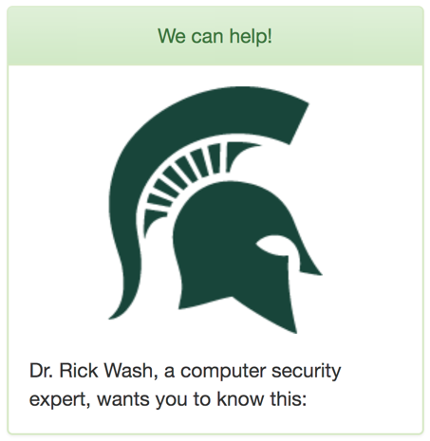
Person Like Me
Expert

Slide 87
Story from An Expert | Story from People Like Me
Advice from An Expert | Advice from People Like Me
No Training - Control

Slide 88
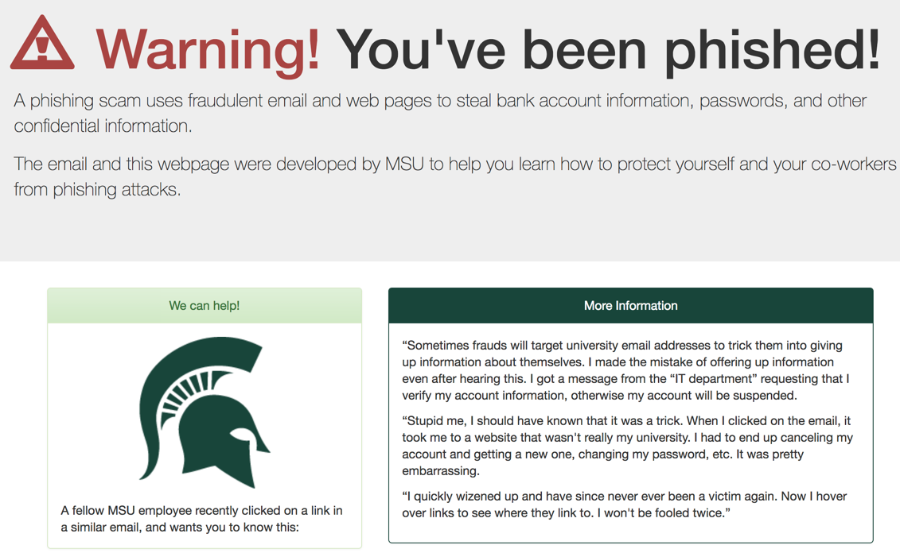

Slide 89
4 Emails sent to 1945 university staff
Day 0
Day 2
Day 7
Day 42
Initial
Short Term
Medium Term
Long Term
Group 1 | 1 | 2 | 3 | 4
Group 2 | 2 | 4 | 1 | 3
Group 3 | 3 | 1 | 4 | 2
Group 4 | 4 | 3 | 2 | 1

Slide 90
25.6% of people clicked on a phishing link
Email | Percent Clicked
Mailbox is almost full | 6%
New Sign-in Attempt | 7%
Upgrading Email Accounts | 12%
Re-validate your mailbox | 8%

Slide 91
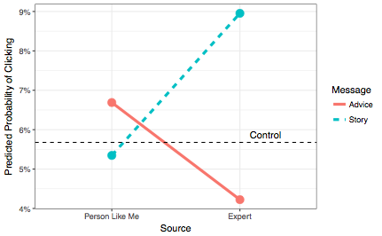

Slide 92
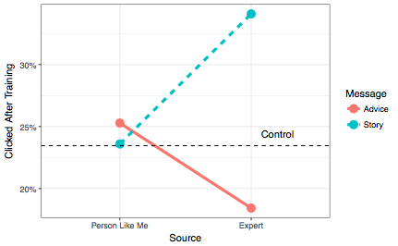

Slide 93
Unfair comparison?
Facts and advice came from industry best practice text
Story came from an undergrad in a research study
Can we do better?

Slide 94
Current work
Collecting more stories
Testing how variety of stories convey typicality
Do people follow actions in stories?
Can stories support cause-and-effect reasoning?
Notes:
Return to idea that current stories don’t provide what to do
training; stories are how people learn
But not all stories are useful, and we might be able to identify or craft more useful ones

Slide 95
Thank you!
Rick Wash
Michigan State University
wash@msu.edu
http://rickwash.com
This material is based upon work supported by the National Science Foundation under Grant No. 1116544 and 1714126 and by MSU’s Office of the CIO
Special thanks to collaborators and co-authors on this work: Emilee Rader, Brandon Brooks, Molly Cooper, Rob McCurdy, Nate Zemanek, Chris Fennell, Janine Slaker, Kami Vaniea, Michelle Rizor, Katie Hoban, and the rest of the BITLab team

